Slide 1

AMCAT Data Analysis
By :
Dasari vijay kumar
IN9249116

Slide 2
About me​
"My name is Dasari Vijay Kumar. I hold a Btech in Mechanical Engineering and am currently concentrating on Data Science. This field fosters innovation and the development of advanced technologies, such as intelligent machines and autonomous robots capable of performing tasks independently."
GitHub : https://github.com/dasarivijay1999
Linkedin : https://www.linkedin.com/in/vijaykumardasari/

Slide 3
Agenda
Introduction :
The dataset comes from AMCAT, an organization that administers tests for engineering students seeking employment.
The results are shared with recruiters, who then invite high-performing students for direct interviews.
Objective :
Based on students' performance in the AMCAT test and their engineering background, you can determine factors such as salary, job titles, job locations, and employment roles.

Slide 4
I Used these Libraries :
Data Cleaning Steps :
Numpy
pandas
Matplotlib
Seaborn
Understand the data
Correcting the datatypes
Handling missing values
Handling Outliers
Check the Duplicates

Slide 5
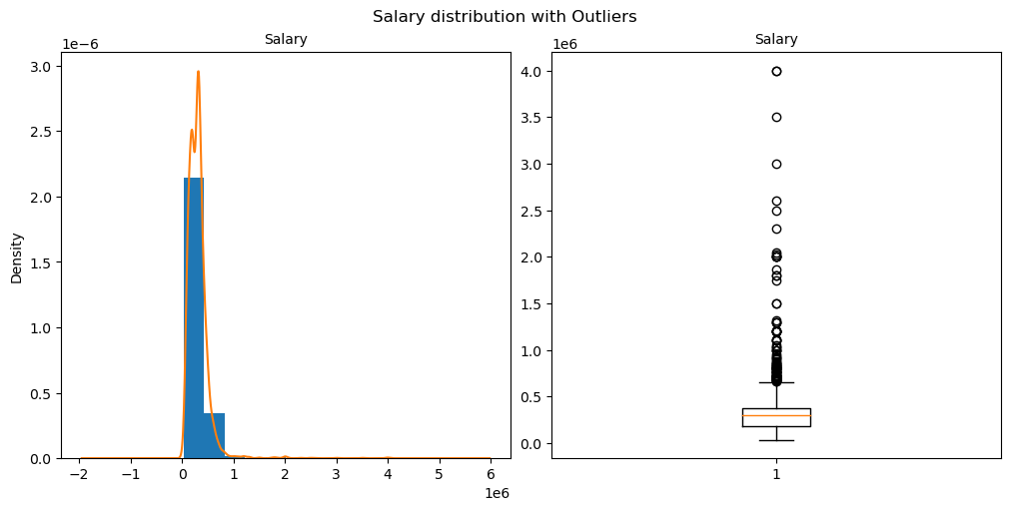
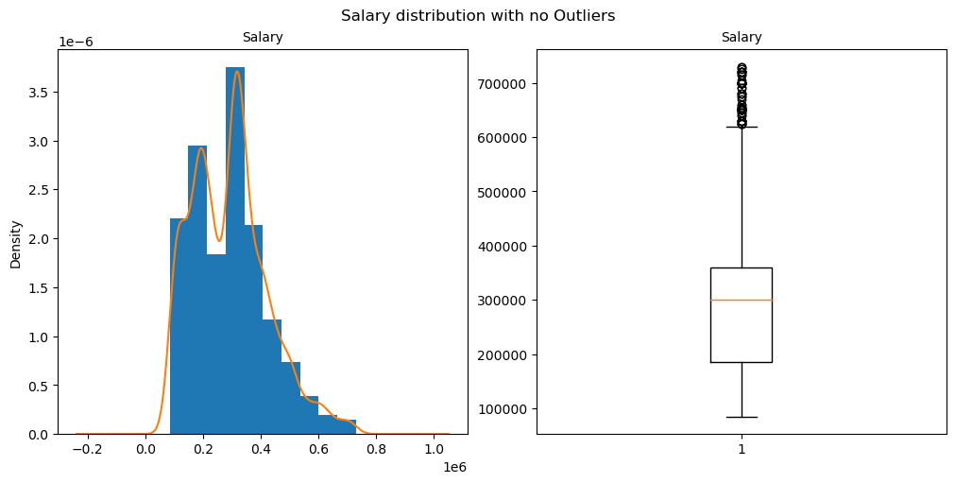
Handling Outliers in Target column : Salary
Before Outliers
After Outliers

Slide 6
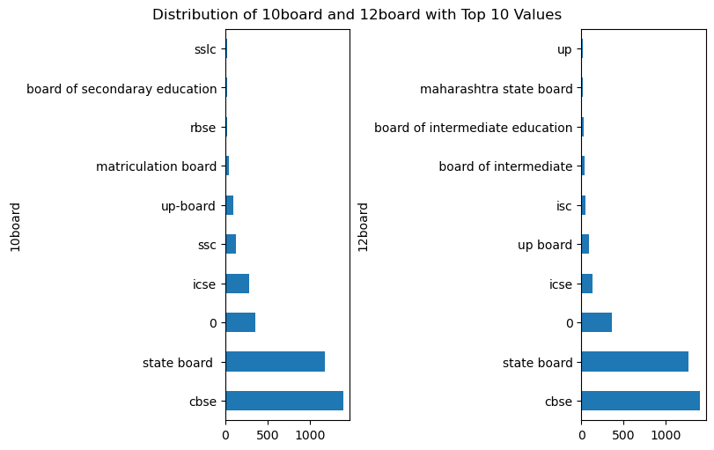
Univariate Analysis : Categorical ​
The majority of students completed their 10th and intermediate education through the CBSE board.

Slide 7
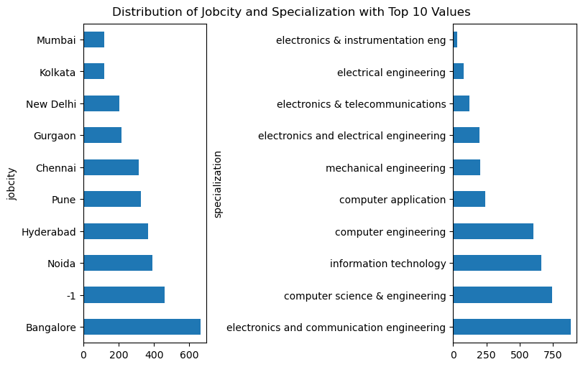
Univariate Analysis : Categorical
Job city : Majority of the students got job in Bangalore.
Specialization : Majority of the students completed their degree in electronic and communication engineering.

Slide 8
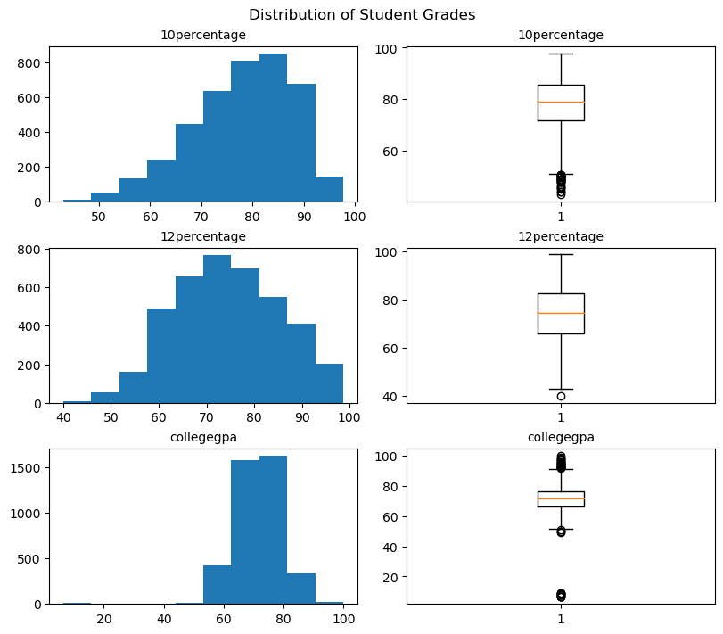
Univariate Analysis : Numerical
The majority of students achieved strong results in their 10th and 12th grades, with scores ranging from 70% to 90%. However, their college GPAs display wider variation, with some students performing significantly better or worse than others.

Slide 9
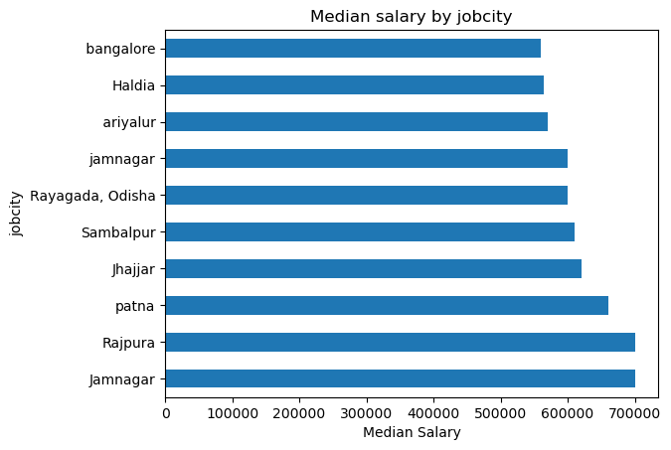
Bivariate Analysis : Numerical​ vs Categorical
Students who obtained jobs in Jamnagar and Rajpura earn the same average salary, which is higher compared to those in other cities.

Slide 10
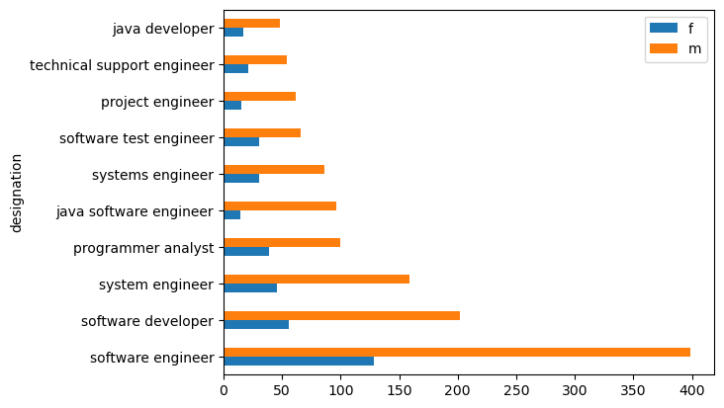
Bivariate Analysis : Categorical vs Categorical​
In every designation, there are more males than females, with software engineering employing the highest number of both male and female employees.

Slide 11
Conclusion : ​
In every designation, there are more males than females, and the software engineering field has the highest number of employees for both genders.
Students employed in Jamnagar and Rajpura receive the same average salary, which is greater than the average salary in other cities.
Most students achieved good results in their 10th and 12th grades, with scores largely ranging from 70% to 90%. However, college GPAs demonstrate more variation, as some students excel while others fall behind.
Job city : Majority of the students got job in Bangalore.
Specialization : Majority of the students completed their degree in electronic and communication engineering.
majority of students studied their 10th and intermediate in cbse .

Slide 12

THANK YOU

